Slide 1

Air Quality in India
Professor Dawn Owens
Group Members: Neil Ray, Victor Nava, Hridya Vakkalanka

Slide 2
Overview
Project Description
Conceptual Model/ERD
Insights
Challenges & Solutions
Major Takeaways

Slide 3
Project Overview
Our project focuses on Air Quality in India by examining air pollutants and how they relate to the Air Quality Index (AQI)
Our dataset comes from Kaggle that analyzed India’s air quality at the City level and air-quality stations level
Our goal was to identify air pollutants that correlated with good/bad air quality in India

Slide 4
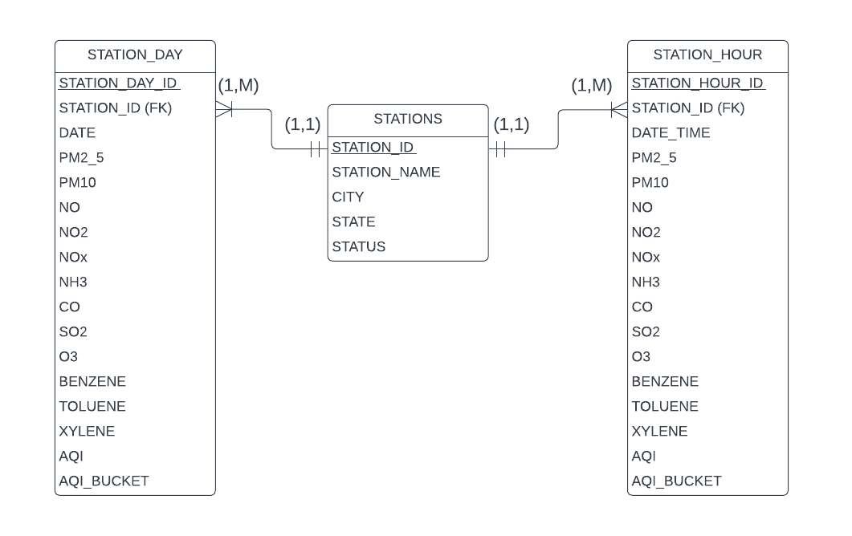
Conceptual Model/ERD

Slide 5
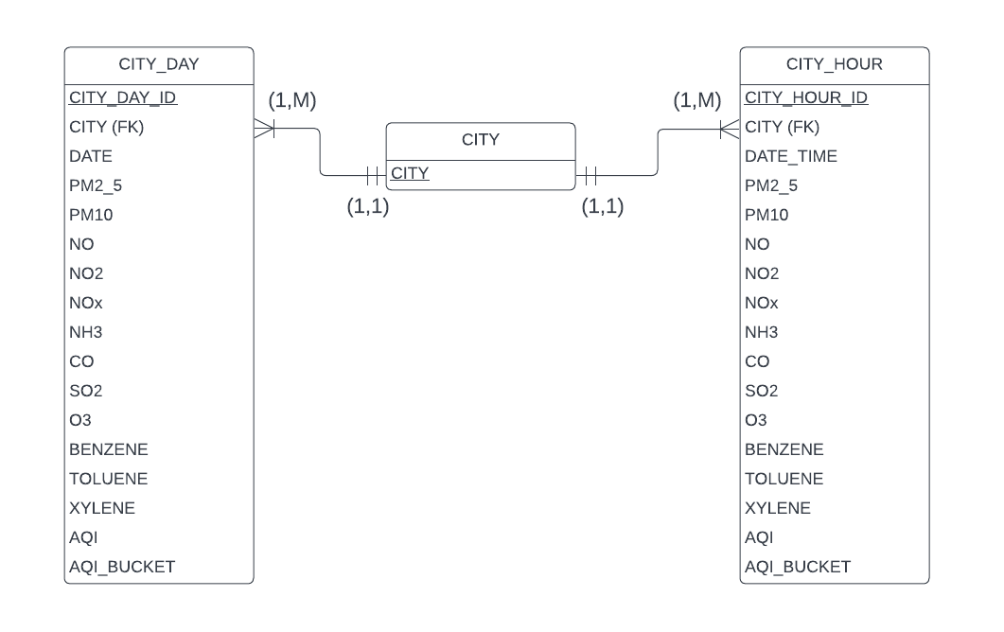
Conceptual Model/ERD

Slide 6
Insights
Particulate Matter 2.5 (PM2.5) was lowest in Shillong, a small city away from the India’s biggest urban centers
PM2.5 was highest in Delhi, India’s capital and one of its largest urban/business centers
PM2.5 is quite dangerous as it is so small that it can enter deep in the body and prolonged exposure can lead to adverse health conditions
As such, one major insight was it seems living close to major cities (like Delhi) could prove harmful to one’s health, while living further away from congested cities could be better, air-quality wise.

Slide 7
Insights
Air Quality Index (AQI) is a general measure of air quality, where the higher the AQI value is, the greater air pollution level, and thus greater risk for one’s health
An AQI of 100 is considered the default benchmark value for air quality and AQI’s much greater than 100 are particularly harmful
The average AQI for India was 99 which is quite good.
8224 cities had Satisfactory AQI responses, 8829 cities had Moderate AQI responses, and only 1338 cities had Severe AQI responses
This means the vast majority of India is living in relatively good air quality

Slide 8
Challenges & Solutions
One of the biggest challenges with this project was the data import from Kaggle into SQL. There was data schema issues, missing values, and outliers.
Additionally, another major issue was writing the SQL commands to create the SQL database and as well as the SQL queries necessary to derive our insights.
Nevertheless, through collaborating and dedication, we were able to successfully accomplish this project.

Slide 9
Major Takeaways
The vast majority of India’s cities have at least “moderate” or better AQI values
The major cities of India seem to have the worst air quality and thus could pose health risks for its citizens
As such, efforts to curb air pollution could be focused around major Indian cities to help minimize adverse health effects on its citizens

